Slide 1
CLEAN WATER AND SANITATION

Slide 2
GROUP MEMBERS
SERIAL NUMBER | NAME
1 | SHREYA BASU
2 | SAHELI PAL
3 | ANWESHA BANERJEE
4 | ARIJIT CHATTERJEE
5 | PRITAM KUMAR MUKHOPADHYAY

Slide 3
Our project is based on the topic – “Clean water and sanitation”. We have created a website in which we have given the need for clean water and sanitation and we have given the details of the water and the water is safe for drinking or not of various areas after getting input from users.

Slide 4
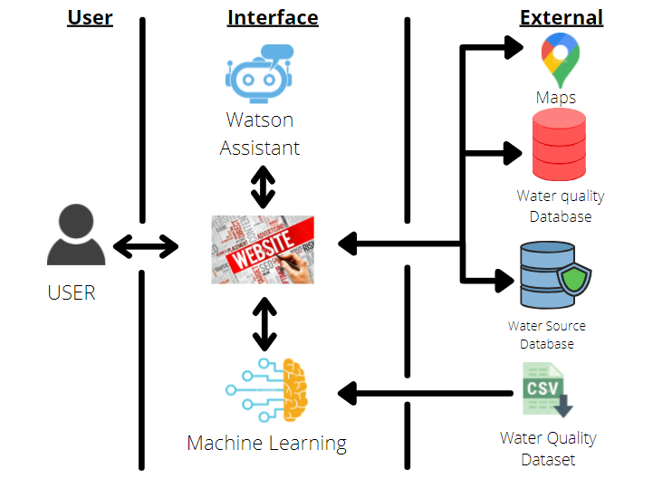
ROAD MAP OF OUR PROJECT

Slide 5
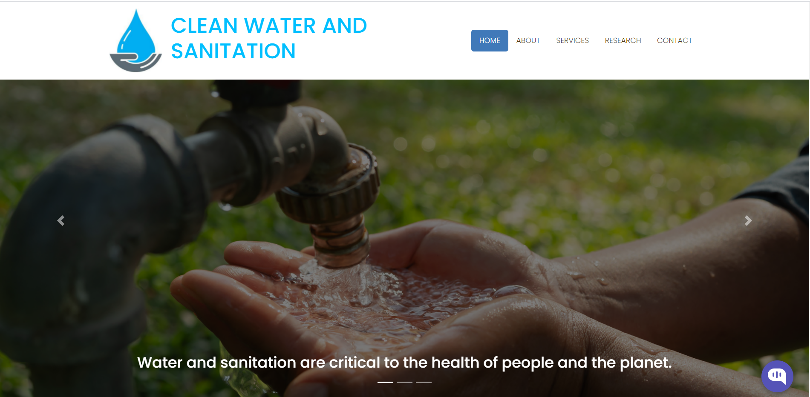
This is the first page of our website which contains a navigation bar which contains Home, About etc pages along with some details of our work.

Slide 6
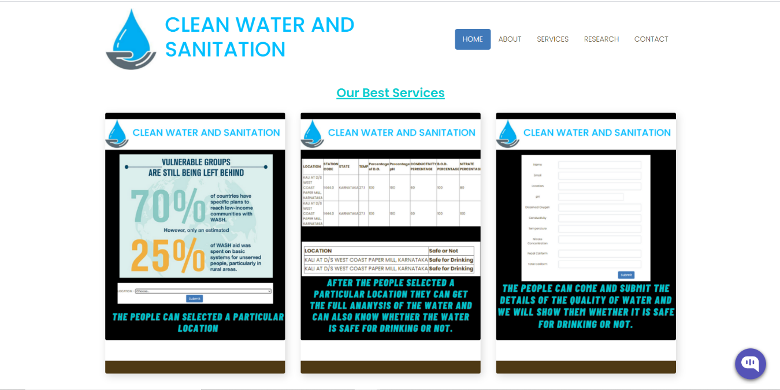
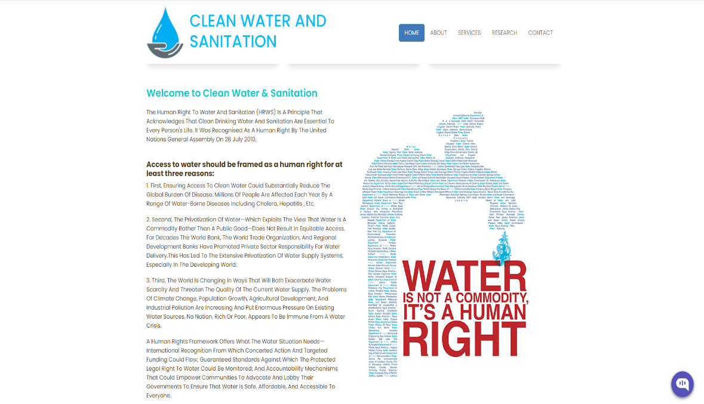
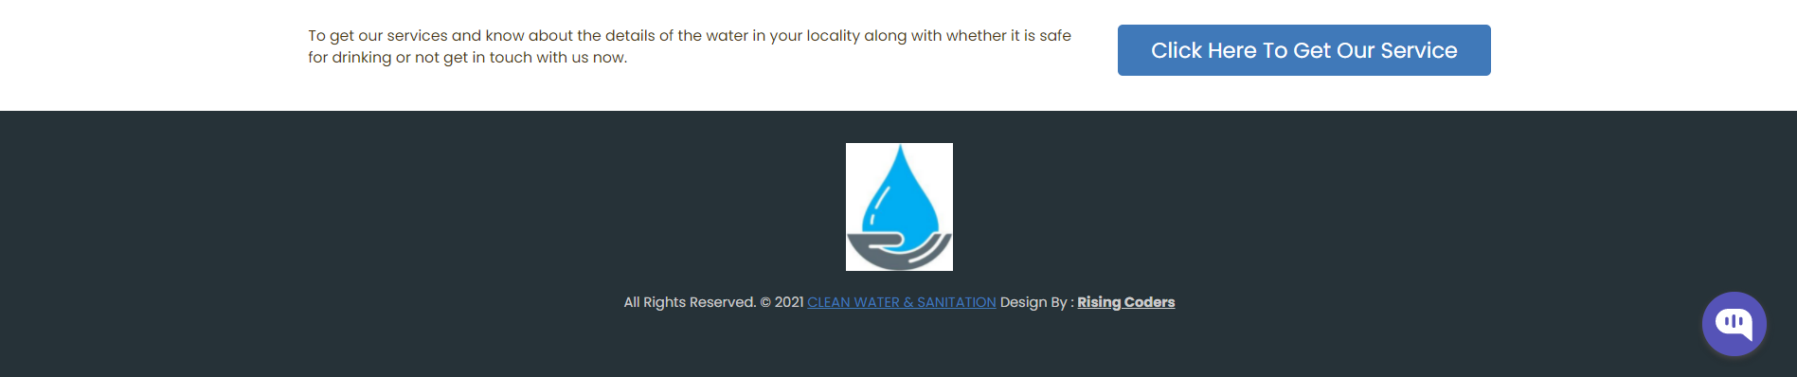
THE FIRST PAGE OF THE WEBSITE SHOWS US THE BEST SERVICES PROVIDED AND TELLS THE NEED OF CLEAN WATER AND SANITATION.

Slide 7
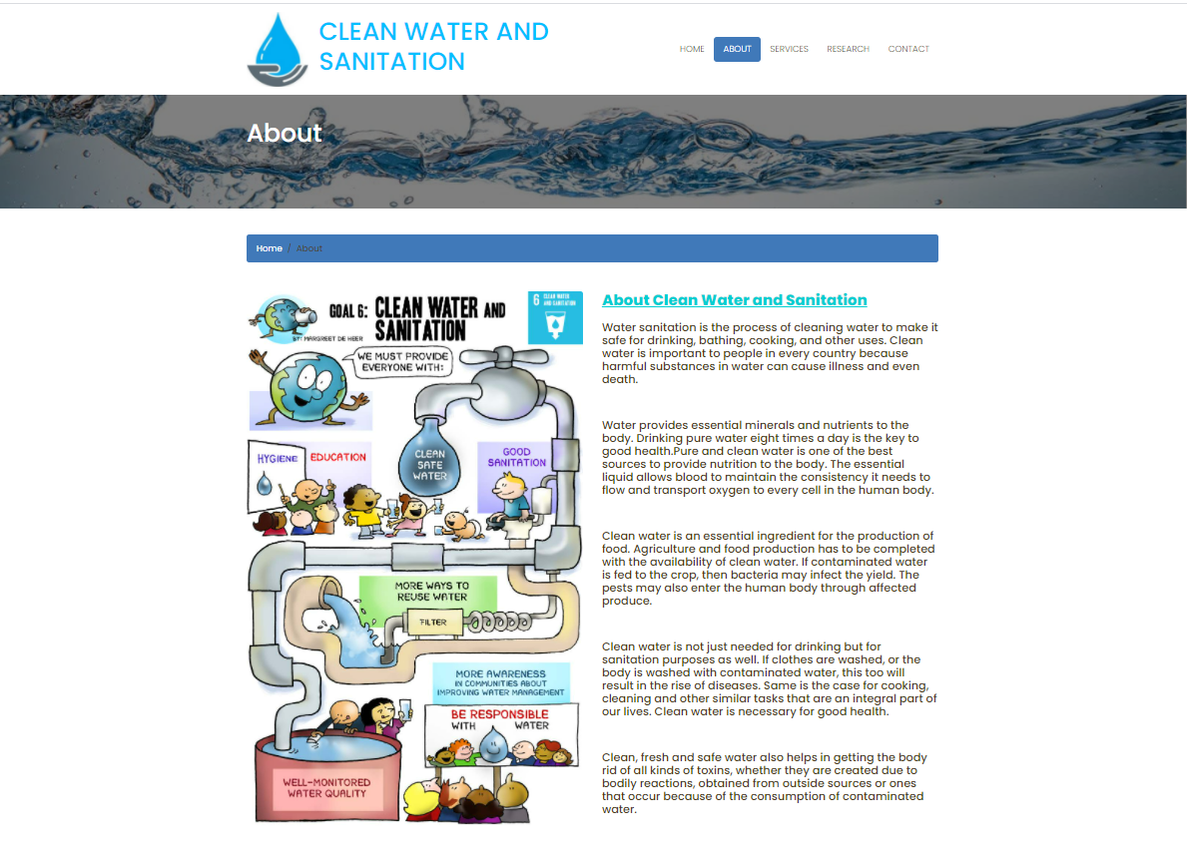
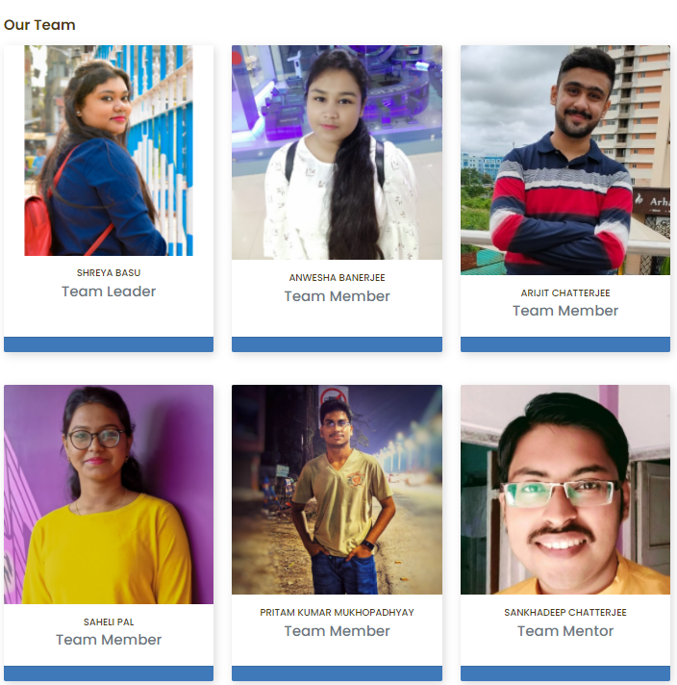
THE ABOUT PAGE CONTAINS DETAILS ABOUT THE REQUIREMENT OF CLEAN WATER AND SANITATION ALONG WITH OUR TEAM MENTOR AND MEMBERS WHO HAVE WORKED VERY HARD TO MAKE THE PEOPLE AWARE OF CLEAN WATER AND HELPED PEOPLE TO KNOW ABOUT WHETHER THE WATER IS SAFE OR NOT FOR DRINKING.

Slide 8
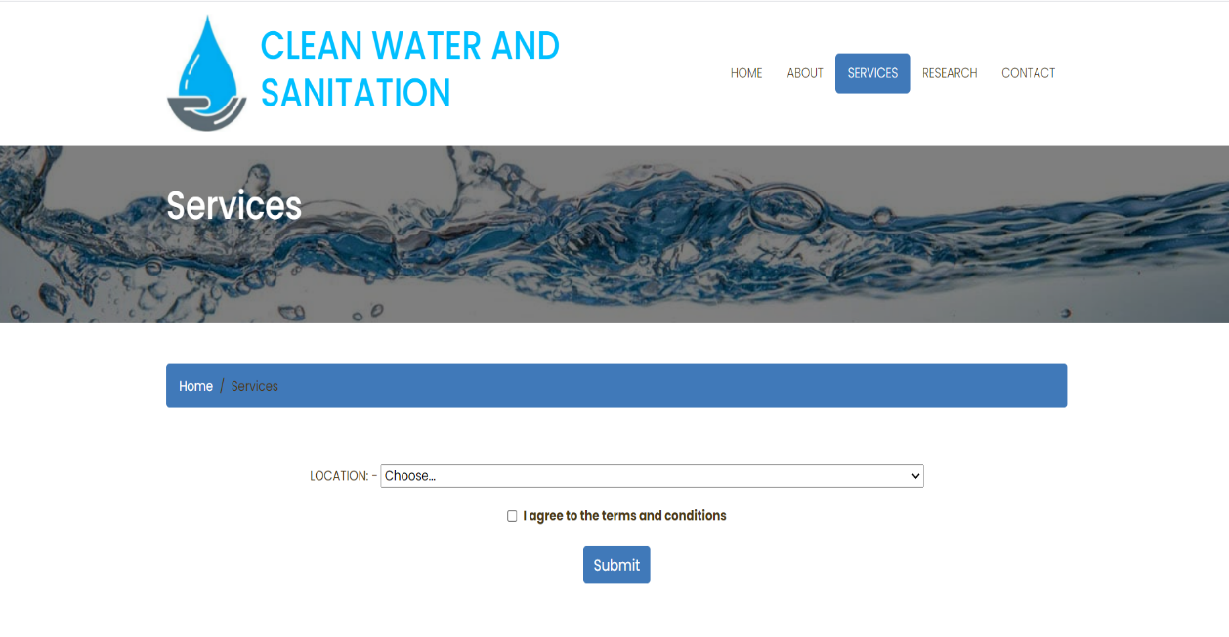
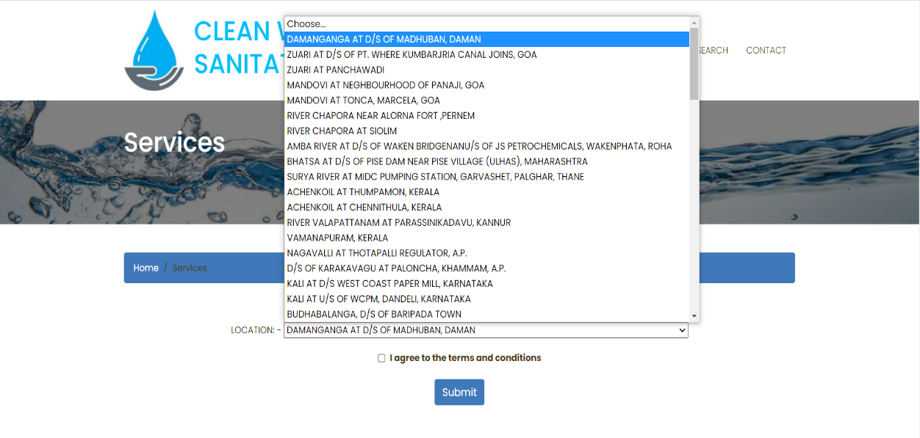
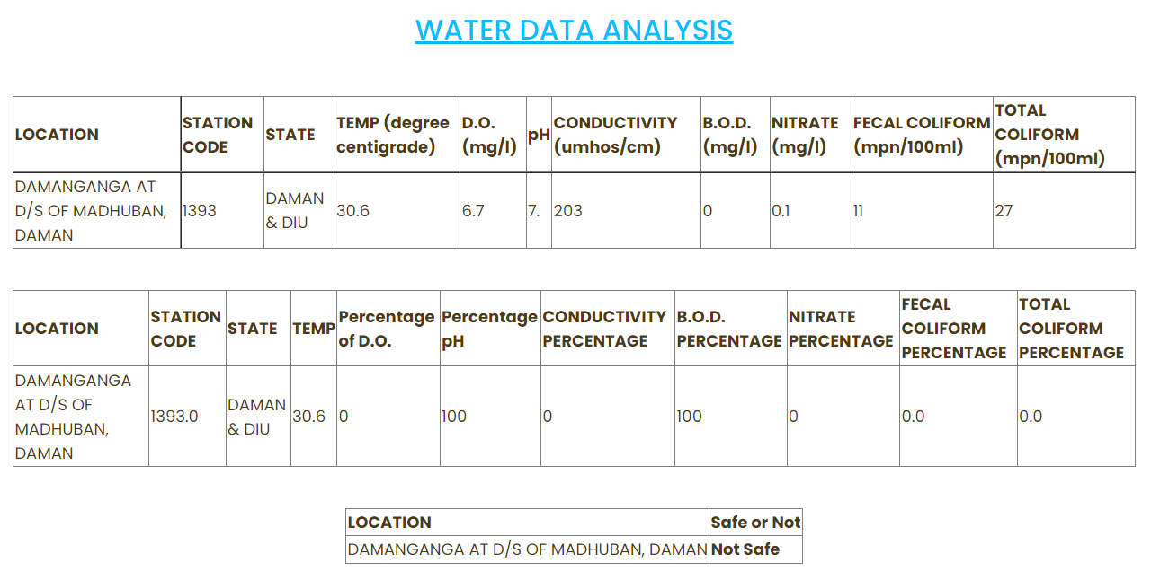
IN THE SERVICES PAGE AT FIRST USER HAVE TO SELECT THEIR LOCATION AND SUBMIT IT. WE WILL GIVE THE DETAILS OF THE WATER IN THAT LOCATION AND TELL THEM WHETHER IT IS SAFE FOR DRINKING OR NOT.

Slide 9
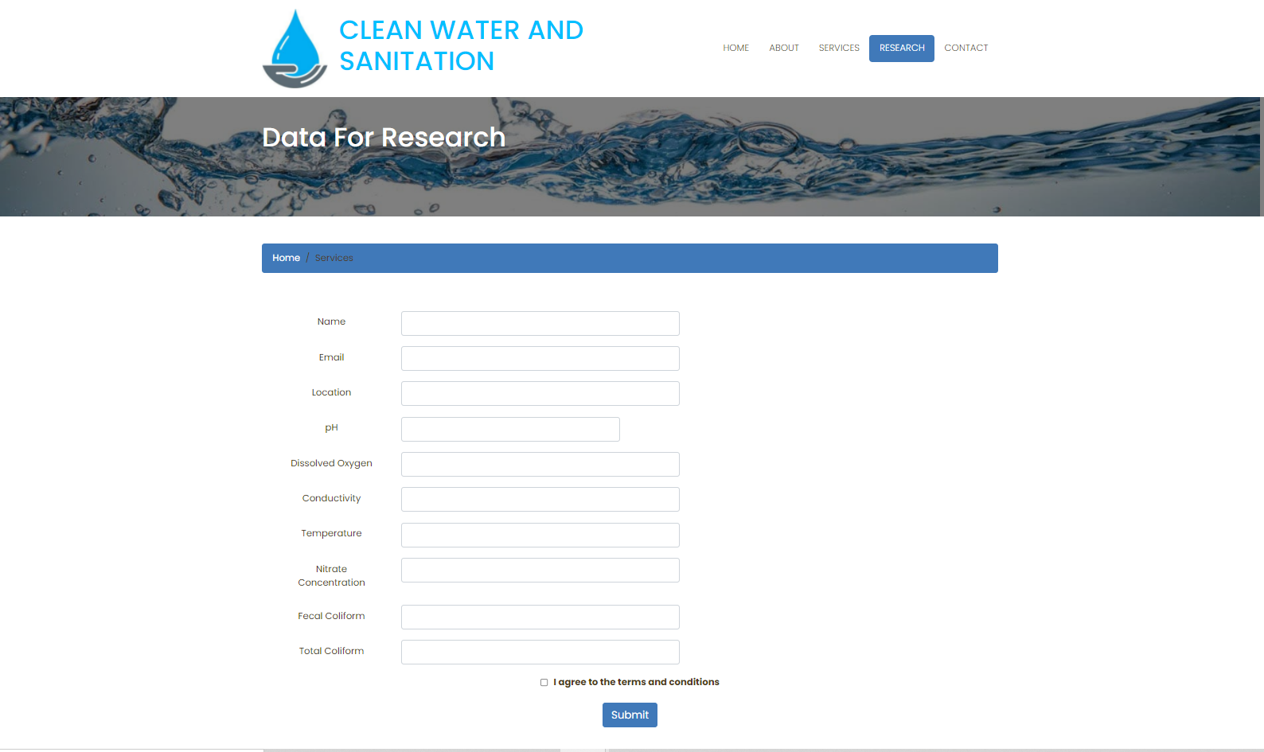
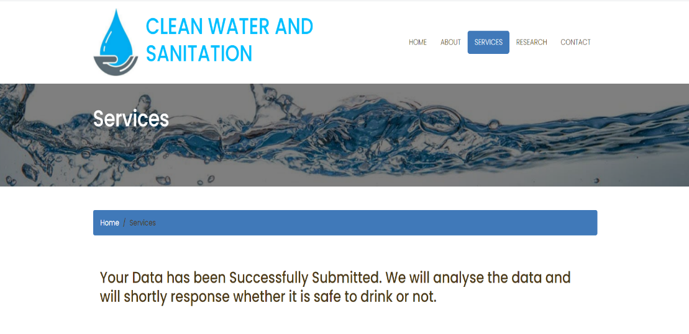
HERE PEOPLE CAN SUBMIT THEIR NAME,EMAIL ID AND LOCATION ALONG WITH THE DETAILS OF THE WATER IN THEIR LOCATION AND WE WILL TELL THEM WHETHER THE WATER IS SAFE OR NOT.

Slide 10
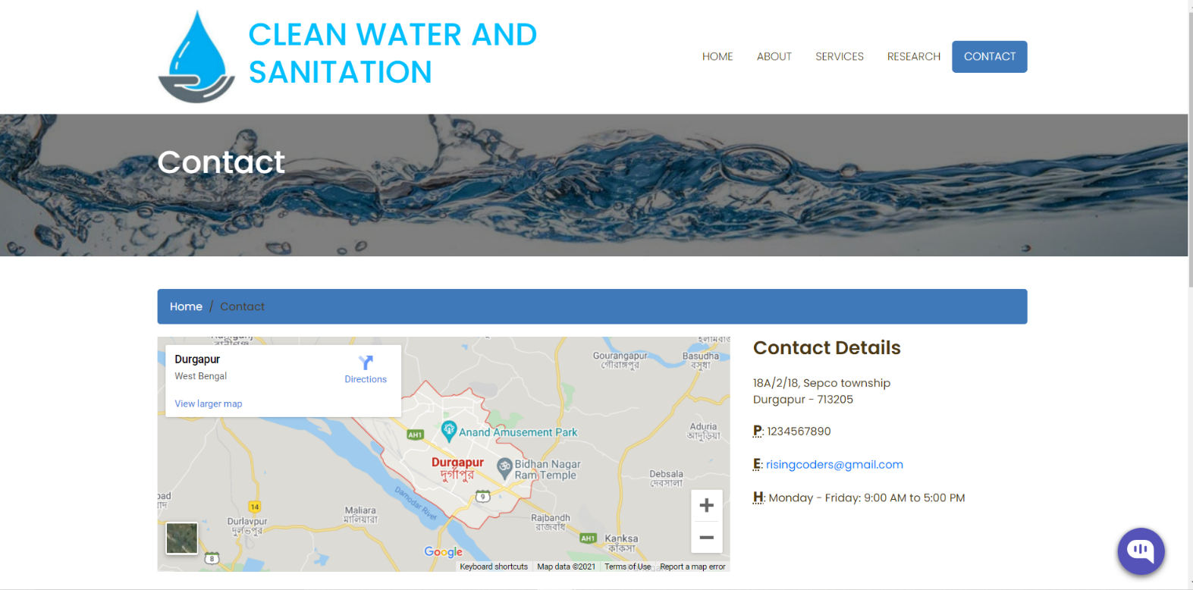
IN THE CONTACT PAGE WE HAVE PROVIDED OUR GROUP MEMBERS DETAILS SO THAT PEOPLE CAN CONTACT US

Slide 11
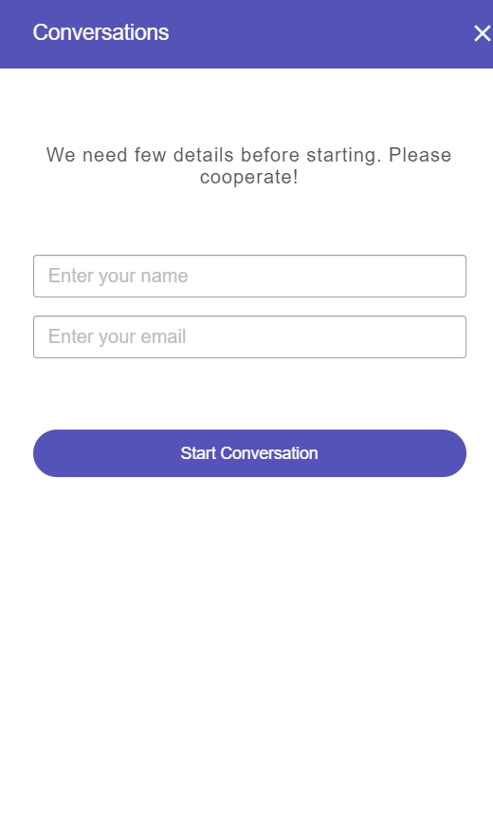
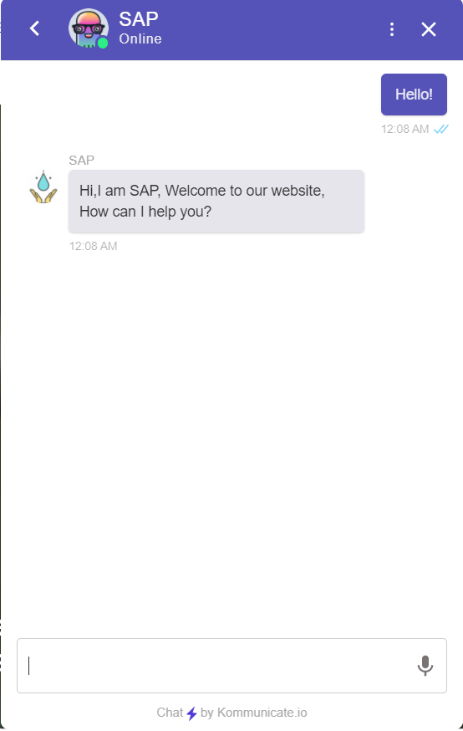
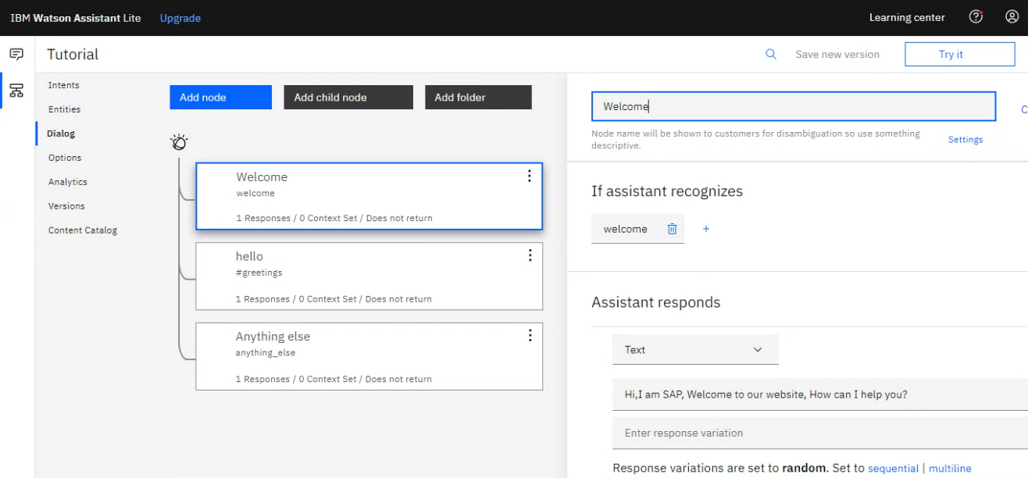
WE HAVE ADDED A SPECIAL CHATBOT USING IBM WATSON ASSISTANT WHICH WILL ASK FOR NAME AND EMAIL ID AT FIRST AND THEN GIVE ANSWERS TO ANY QUERIES ASKED BY THE USER.

Slide 12
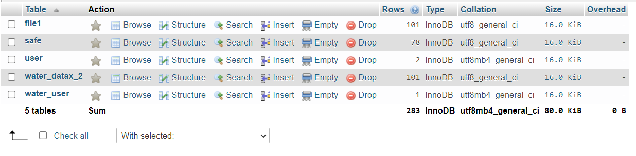
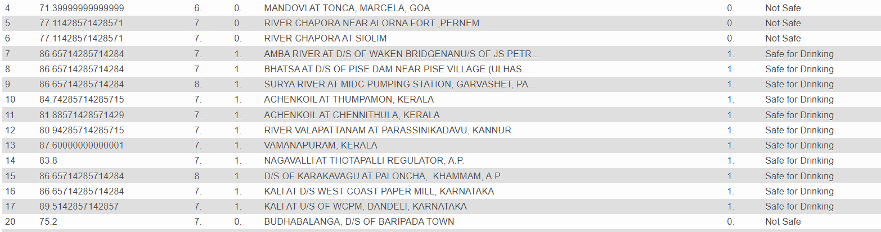
THIS IS OUR DATABASE WHERE ALL INFORMATIONS RELATED TO OUR PROJECT ARE STORED.

Slide 13
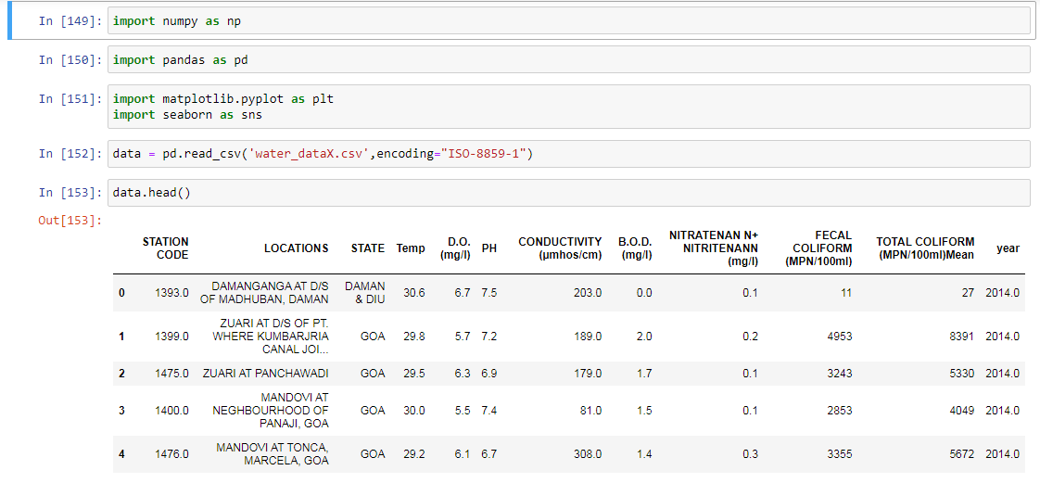
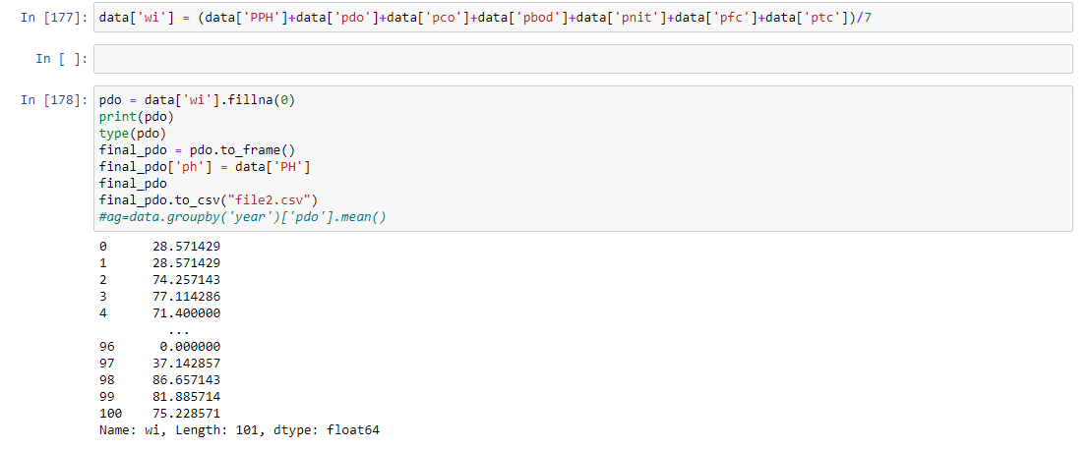
HERE WE HAVE IMPORTED THE DATASET AND USE SOME FUNCTION LIKE head() AND CONTERTED THE DATA.

Slide 14
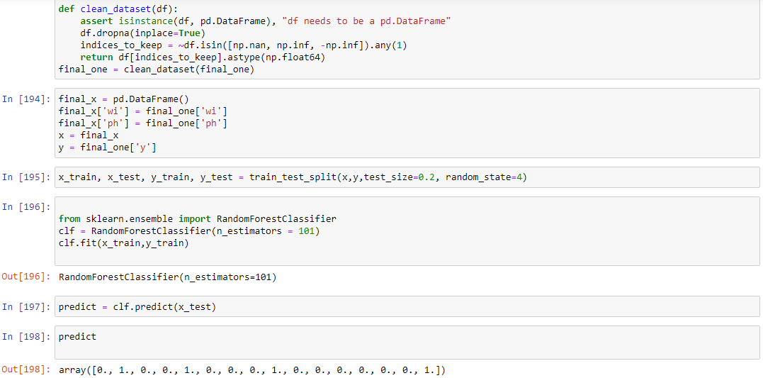

WE HAVE PREDICTED THE QUALITY OF WATER USING MACHINE LEARNING ALGORITHM. WE HAVE TAKEN A DATASET AND HAVE FORMATTED THE DATA TO FIT INTO THE MACHINE LEARNING MODEL. WE HAVE TRAINED THE MODEL USING RANDOM FOREST CLASSIFIER AND IT HAS GIVEN US A PERFECT EFFICIENCY OF 100%.

Slide 15
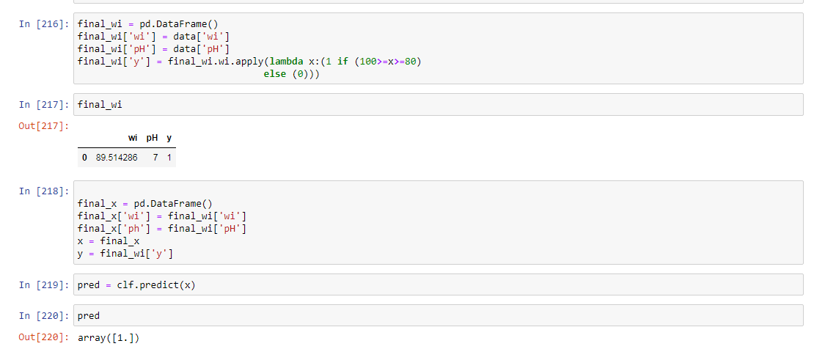
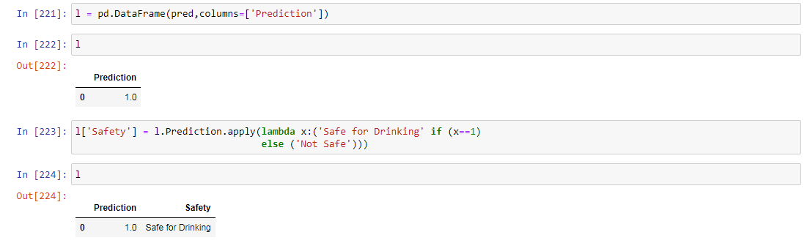
FROM THE RESEARCHER PORTAL, THE DATA IS STORED IN OUR DATABASE. WE HAVE CONNECTED MYSQL WITH PYTHON AND PREDICTED WHETHER THE WATER IS SAFE FOR DRINKING PURPOSE OR NOT.

Slide 16
THANK YOU
FROM RISING CODERS.

